Slide 1
SFIA2 Project
Bailey Elson

Slide 2
Project Specification
Create an application composed of at least 4 services that work together.
Service #1
Renders user interface
Persists data to SQL database
Service #2 + #3
Generate a random “Object
Service #4
Generate an “Object” based upon the results of service #2 + #3

Slide 3
Requirements
Four Service Application
Risk Assessment
Kanban Board
CI server with webhook
Deployed to a cloud-based virtual machine
Follow the Micro Services architecture
Deployed using docker
Create an Ansible Playbook

Slide 4
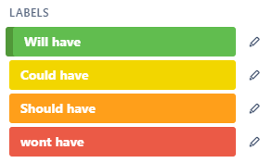
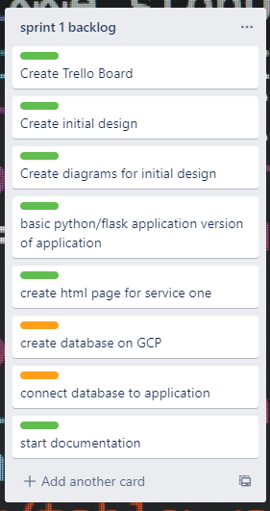
Trello Board - Sprints

Slide 5
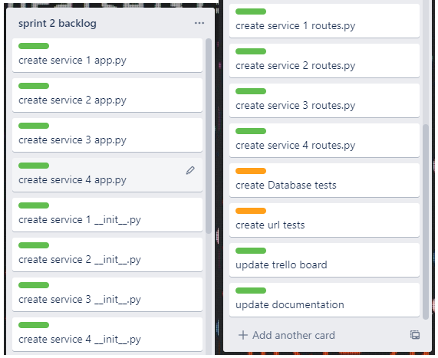
Trello Board - Sprints

Slide 6
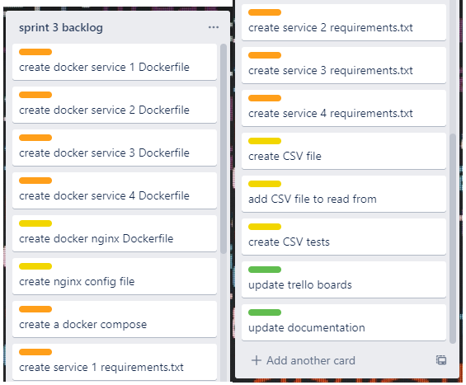
Trello Board - Sprints

Slide 7
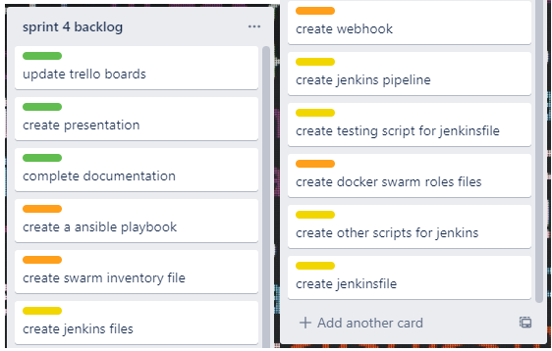
Trello Board - Sprints

Slide 8
Risk Assessment
Go to external file

Slide 9
My initial idea
A radnom prize generator Service #1:
Renders HTML user interface
Calls service #4 to start the generation of prize
Stores the prize in a SQL database
Service #2:
Generates the type of prize (good, average, bad)
Service #3:
Generates the prize from a list based on the prize type
Service #4:
Calls service #2 and #3
Generates the output sentence based on service #2 and #3 return values

Slide 10
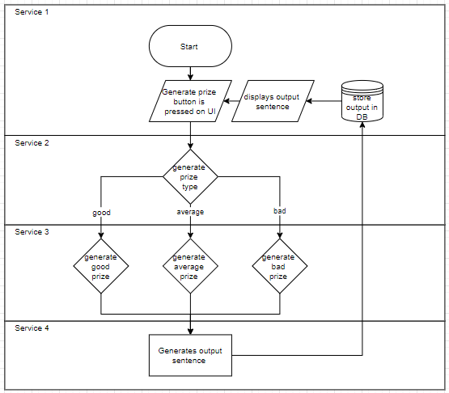
Original Design

Slide 11
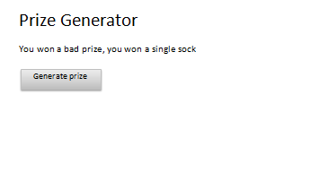
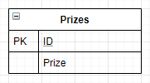
Original Design

Slide 12
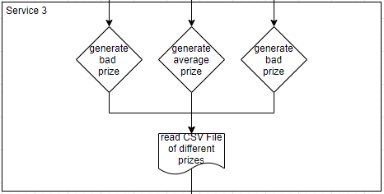
Final Design

Slide 13
My Solution
http://35.230.134.136/

Slide 14
Deployment
Github push
Jenkins pipeline starts
Ansible script runs
Docker script runs
Testing script runs

Slide 15
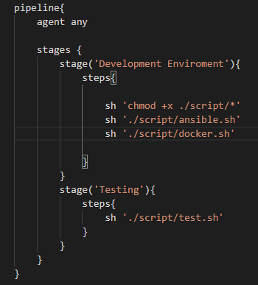
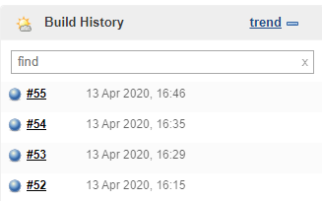
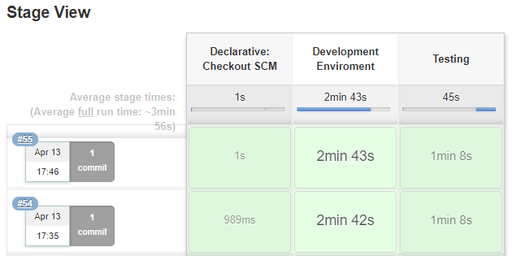
Jenkins

Slide 16
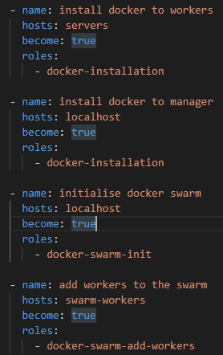
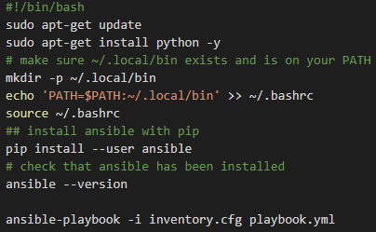
Ansible

Slide 17

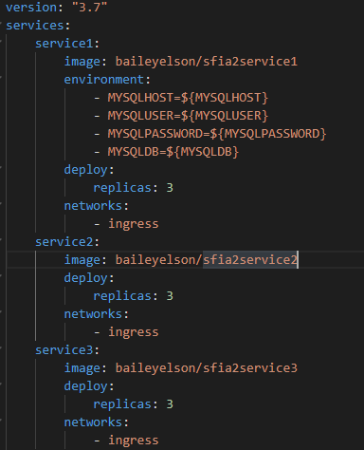
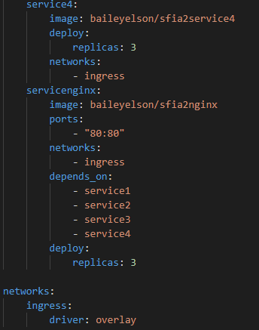
Docker

Slide 18

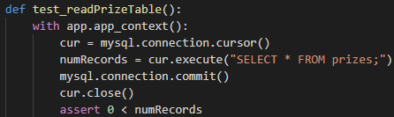

Testing
URL Testing:
Database Testing:
CSV File Testing:

Slide 19
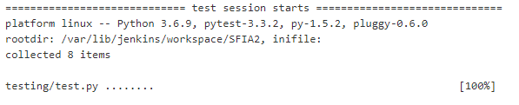
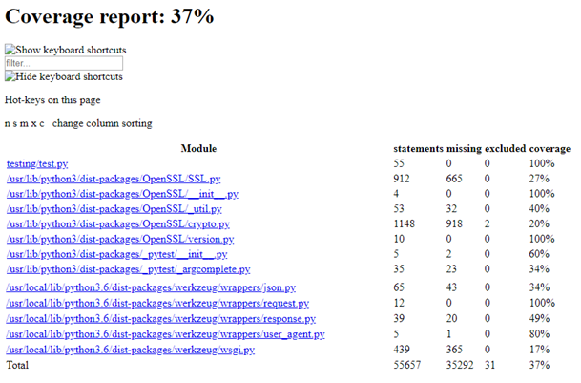
Testing Results

Slide 20

Evaluation
Four Service Application
Risk Assessment
Kanban Board
CI server with webhook
Deployed to a cloud-based virtual machine
Follow the Micro Services architecture
Deployed using docker
Create an Ansible Playbook

Slide 21
Evaluation
What went well:
CSV file implementation
Jenkins pipeline
What I could improve:
Testing Covereage
Security of IP addresses

Slide 22
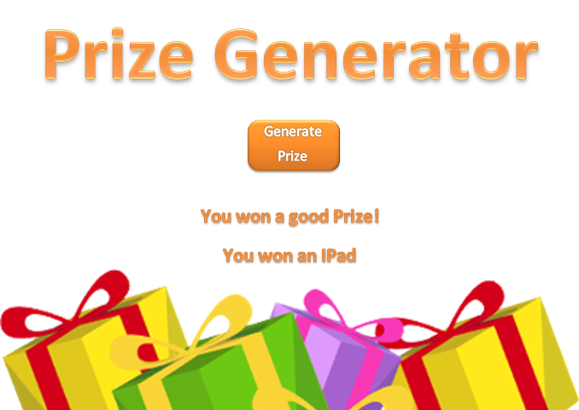
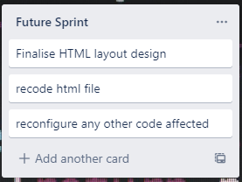
Future Implementations Redesign of user interface

Slide 23
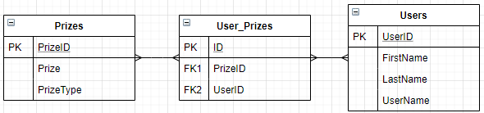
Future Implementations Expanded Database

